Slide 1





Zomato Restaurant Data Analysis
Team : Amar Kamthe Guide: Mr-A.Dambale
Email : amarkamthe22@gmail.com
Disclaimer: The content is curated for educational purposes only.
Notes:
Slides: Prepare a short slide deck (10-12 slides) summarizing the project objectives, methodology, and key results.

Slide 2
OUTLINE
Abstract of the Project
Problem Statement
Proposed Solution
System Architecture
Output ScreenShorts
Github Link
Conclusion
Future Scope

Slide 3

Abstract
This project explores Zomato’s restaurant dataset to analyze ratings, pricing, cuisines, and city-wise distribution. The study involves data cleaning, exploratory data analysis (EDA), and visualizations to identify trends in restaurant performance. Various insights, such as the most popular cuisines, the relationship between price and ratings, and the cities with the highest number of restaurants, are examined. The findings provide valuable information for restaurant owners, food enthusiasts, and businesses to understand customer preferences and market trends. Future enhancements may include predicting restaurant ratings using machine learning for deeper insights. 🚀

Slide 4
Problem Statement-
This project analyzes Zomato restaurant data to identify trends in ratings, pricing, cuisines, and city-wise distribution. The goal is to provide data-driven insights to help businesses improve services, assist customers in decision-making, and uncover market opportunities.

Slide 5
Proposed Solution
📌 Purpose: The project aims to analyze Zomato restaurant data to understand ratings, pricing, cuisines, and city-wise distribution. It helps restaurant owners, customers, and businesses make data-driven decisions about restaurant performance and customer preferences.
✅ Solution: By applying data cleaning, exploratory data analysis (EDA), and visualizations, this study uncovers trends in restaurant ratings, pricing impact, and popular cuisines. The insights help businesses improve services, assist customers in choosing better dining options, and identify market opportunities. Future work may include predicting restaurant success using machine learning. 🚀

Slide 6
System Architecture

Slide 7
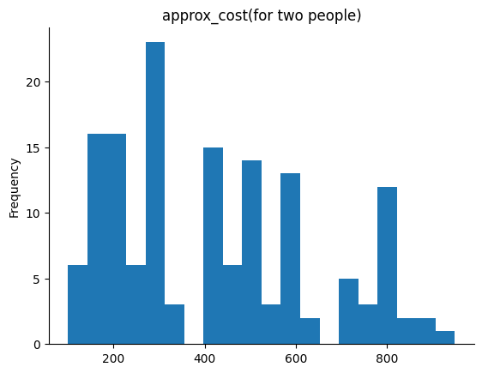
Output ScreenShorts
This histogram shows the. The X-axis represents cost, and the Y-axidistribution of approximate cost for two people at restaurantss represents frequency. The most common price range is around 200–400, with multiple peaks indicating clustered pricing categories. 🚀

Slide 8
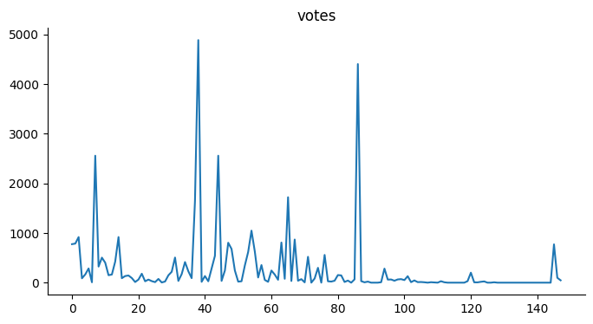
Output ScreenShorts
This line plot shows the distribution of restaurant votes. The X-axis represents restaurant count, and the Y-axis represents votes. There are sharp peaks, indicating a few restaurants have high votes, while many have low to moderate votes.

Slide 9
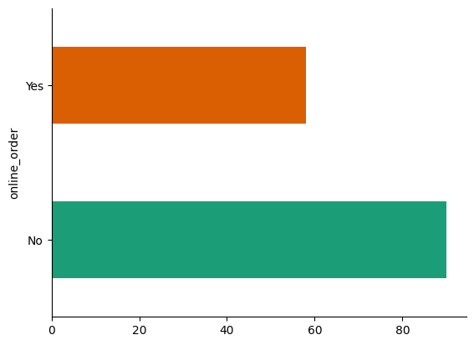
Output ScreenShorts
This horizontal bar chart represents the availability of online ordering in restaurants.
X-axis: Number of restaurants.
Y-axis: Online order availability (Yes/No).
More restaurants do not offer online ordering (longer "No" bar) compared to those that do. 🚀

Slide 10
Github Link

Slide 11
Future Scope
1. Machine Learning Predictions – Predict restaurant ratings based on factors like price, cuisine, and location.
2. AI-Based Recommendations – Develop a restaurant recommendation system based on user preferences.
3. Sentiment Analysis – Analyze customer reviews and feedback to understand restaurant reputation.
4. Geographic Insights – Identify emerging food trends and best-performing locations using geo-analysis.

Slide 12
Conclusion-
This project analyzes Zomato restaurant data to uncover trends in ratings, pricing, and cuisines using EDA and visualizations. The insights help businesses improve services and customers make informed choices. Future work includes ML predictions and AI-based recommendations. 🚀

Slide 13
Thank you!
Notes:
thank you very much for joining this PPT, keep learning.
13

